Slide 1
“Prediction of building energy consumption”
Artificial neural network model for forecasting sub-hourly electricity usage in Commercial buildings. Energy Build 2016;111:184–94.
A hybrid model approach for forecasting future residential electricity consumption. Energy Build 2016;117:341–51.
Energy AI Track Kim Sohee
AI application for energy system
22.06.14
Notes:
A review of data-driven building energy consumption prediction studies
https://doi.org/10.1016/j.rser.2017.04.095

Slide 2

Contents
Prediction models for forecasting building energy consumption
Artificial neural network model for forecasting sub-hourly electricity usage in Commercial buildings
A hybrid model approach for forecasting future residential electricity consumption

Slide 3
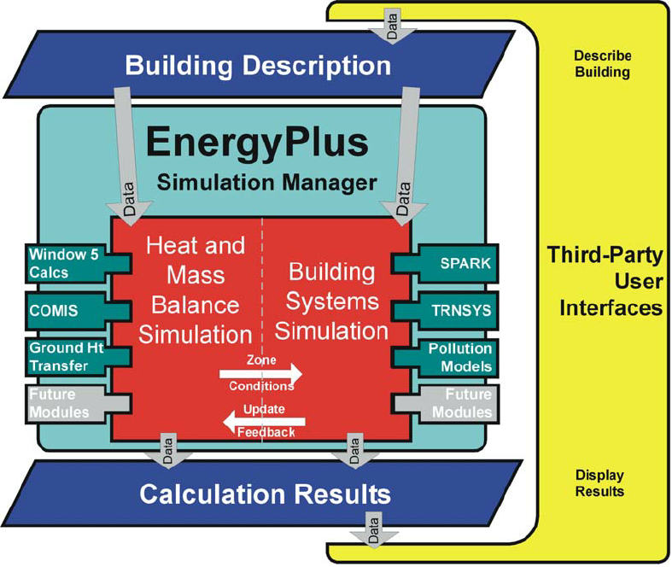
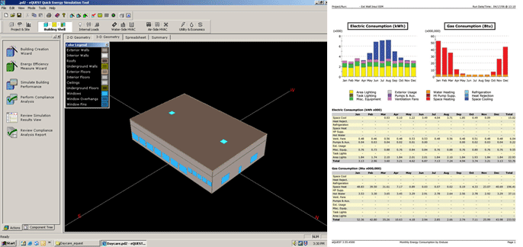
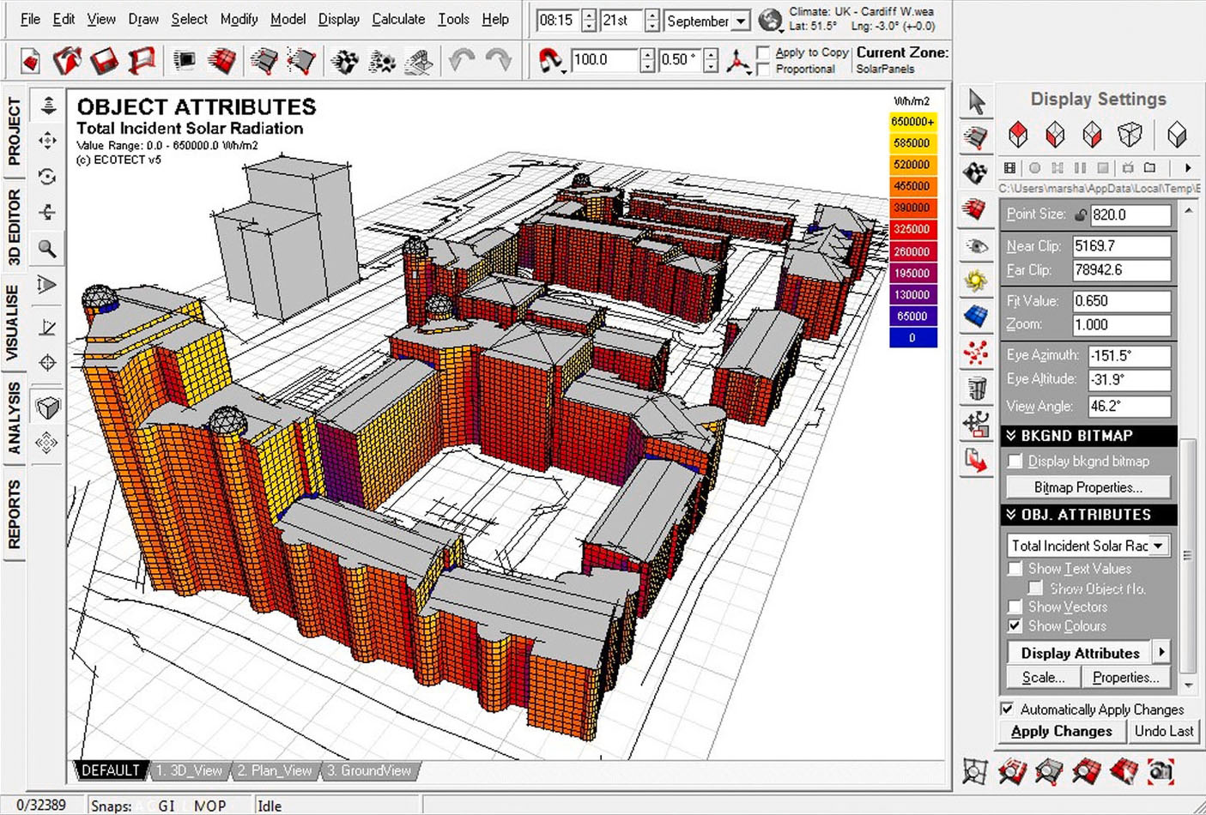
1. Prediction models for forecasting building energy consumption
2. Artificial neural network model for forecasting sub-hourly electricity usage in Commercial buildings
3. A hybrid model approach for forecasting future residential electricity consumption
Prediction models
Engineering models (Physical models)
Rely on thermodynamic rules for detailed energy modelling and analysis
Software : EnergyPlus, eQuest, and Ecotect
Calculate building energy consumption based on detailed building and environmental parameters
Detailed data may not be available to the users at the time of simulation
Failure to provide accurate input can result in poor prediction performance
> EnergyPlus
(whole building energy simulation program)
> eQuest
(Building energy analysis program)
> EcoTect
Notes:
There are several popular methods used for forecasting building energy consumption, that can be categorized into two main approaches, engineering and data-driven approach.
First, Engineering models rely on thermodynamic rules for detailed energy modelling and analysis.
Examples of building energy simulation software that utilize physical models include EnergyPlus, eQuest, and Ecotect.
These types of software calculate building energy consumption based on detailed building and environmental parameters such as building construction details; operation schedules; HVAC design information; and climate, sky, and solar/shading information.
The pictures shows each software program.
EneryPlus is a whole building energy simulation program, and eQuest is a building energy analysis program.
Ecotect is a program that supports architect's design through analysis of various factors of building performance for energy efficiency and sustainable design.
However, some of such detailed data may not be available to the users at the time of simulation.
Failure to provide accurate input can result in poor prediction performance.

Slide 4
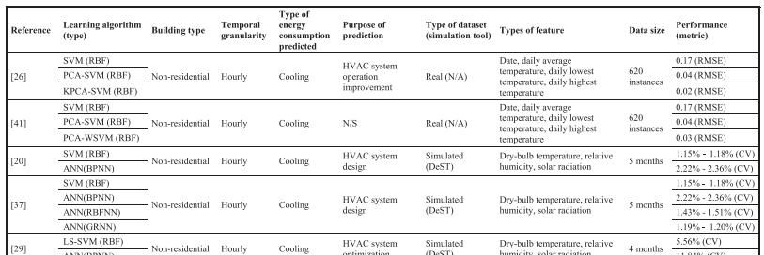
1. Prediction models for forecasting building energy consumption
2. Artificial neural network model for forecasting sub-hourly electricity usage in Commercial buildings
3. A hybrid model approach for forecasting future residential electricity consumption
Prediction models
Data-driven models
Learns from historical/available data for prediction
Correlate the energy consumption or energy index with the influencing variables
4 steps : data collection, data preprocessing, model training, and model testing
Machine learning algorithms : SVM, ANN, decision trees, and other statistical algorithms
Notes:
Data-driven modelling does not perform such energy analysis or require such detailed data about the simulated building, and instead learns from historical/available data for prediction. They correlate the energy consumption or energy index with the influencing variables.
Data-driven prediction has gained a lot of research attention in recent years, despite its possible limitations.
Developing a data-driven model, typically, consists of four primary steps: data collection, data preprocessing, model training, and model testing.
SVM, ANN, decision trees, and other statistical algorithms are the most commonly-used supervised machine learning algorithms for model training.
This table summarizes the features used in the reviewed models.

Slide 5
1. Prediction models for forecasting building energy consumption
2. Artificial neural network model for forecasting sub-hourly electricity usage in Commercial buildings
3. A hybrid model approach for forecasting future residential electricity consumption
Prediction models
Data-driven models Limitations
Data-driven prediction models may not perform well outside of their training range.
Black-box models – their internals are not known
Hybrid or grey-box modelling approaches (physical + data-driven)
Black-box model
Artificial neural network model for forecasting sub-hourly electricity usage in Commercial buildings.
Chae YT, Horesh R, Hwang Y, Lee YM. Energy Build 2016;111:184–94.
Data-driven models
Prediction
models
Physical models
Grey-box model (hybrid)
A hybrid model approach for forecasting future residential electricity consumption.
Dong B, Li Z, Rahman SMM, Vega R. Energy Build 2016;117:341–51.
Notes:
Despite the importance of data-driven approaches, It has two main limitations.
First, Data-driven prediction models may not perform well outside of their training range.
And they are black-box models, their internals are not known.
On the other hand, Hybrid or grey-box modelling approaches offer a combination of physical and data-driven prediction models, thereby leveraging the advantages and minimizing the disadvantages of both approaches.
So, I will present 2 paper which is each about a data-driven model(black-box) and a hybrid model(grey-box).
First is about data-driven, ANN model, and Second is about hybrid model.

Slide 6
2. Artificial neural network model for forecasting sub-hourly electricity usage in Commercial buildings.
1. Prediction models
2. Artificial neural network model for forecasting sub-hourly electricity usage in Commercial buildings
3. A hybrid model approach for forecasting future residential electricity consumption
Chae YT, Horesh R, Hwang Y, Lee YM.
Energy Build 2016;111:184–94.
Notes:
First paper is ‘Artificial neural network model for forecasting sub-hourly electricity usage in Commercial buildings’

Slide 7
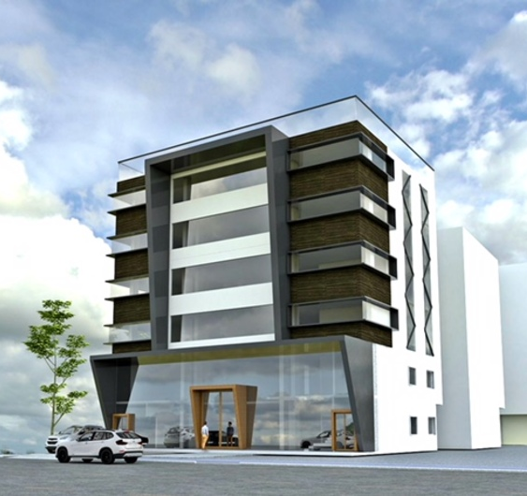
1. Prediction models
2. Artificial neural network model for forecasting sub-hourly electricity usage in Commercial buildings
3. A hybrid model approach for forecasting future residential electricity consumption
Introduction
Forecasting electricity load – commercial & industrial buildings
To be able to better manage energy usage
The short-term load forecast (STLF) – a period shorter than a day → more interest
∵ The utility prices may change by seasonality, time-of-use in on/off peak period, and contract demand
7/30
Notes:
Forecasting electricity load, especially for commercial and industrial buildings has become one of the more important topics recently, to be able to better manage energy usage.
Although the forecast time horizon can range from minutes to years, the short-term load forecast (STLF), especially for a period shorter than a day, has been more of an interest in the perspective of buildings
/ because the utility prices may change by seasonality, time-of-use in on/off peak period, and contract demand.

Slide 8


2. Artificial neural network model for forecasting sub-hourly electricity usage in Commercial buildings
1. Prediction models
3. A hybrid model approach for forecasting future residential electricity consumption
Introduction
The short-term load forecast (STLF) – sub-hourly electricity consumption of buildings
Escriva-Escriva et al. – STLF model using ANNs
Requires an entire whole year’s data set
Not be stable when the energy consumption pattern has large daily or annual variability
A short-term load forecasting model using data mining and machine learning technique while assuming limited availability of data.
ANN models – commercial building complex
Notes:
Previous studies on STLF for the sub-hourly electricity consumption of buildings are limited.
Escriva-Escriva et al. [14] proposed STLF model using ANNs,
but this model requires an entire whole year’s dataset / and the performance may not be stable when the energy consumption pattern has large daily or annual variability.
Therefore, it is useful to explore a model that can perform well under more general setting, in particular, not requiring a large amount of input data for forecasting electricity usage of buildings.
For this need, they developed a short-term load forecasting model using data mining and machine learning technique while assuming limited availability of data.
In particular, they investigate ANNs model to predict the energy consumption of a commercial building complex.

Slide 9
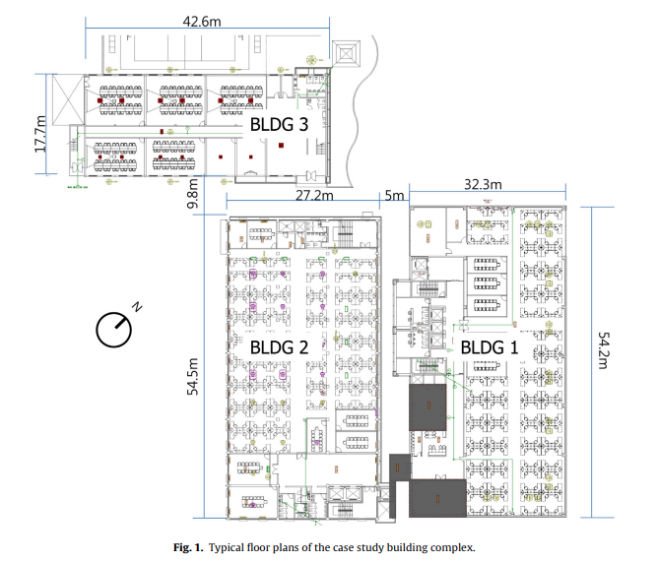
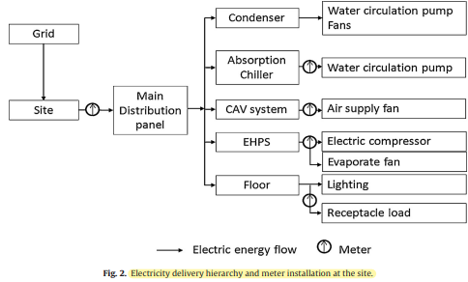
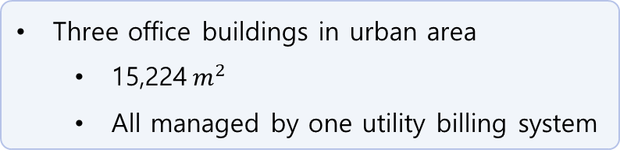
1. Prediction models
2. Artificial neural network model for forecasting sub-hourly electricity usage in Commercial buildings
3. A hybrid model approach for forecasting future residential electricity consumption
Methodological approach
Description of a case study: a building complex
Two absorption chiller systems
Constant air volume (CAV) – BLDG 1
Fan coil units (FCU) – BLDG 2
Electric heat pump (EHP) – BLDG 1, 2, 3
Building management system (BMS) : monitor operational conditions
2 floor
4 floor
5 floor
Three office buildings in urban area
15,224$m^{2}$
All managed by one utility billing system
Notes:
All data set for this study was obtained from a building management system (BMS) of a commercial office building complex, and the data are periodically pulled into a relational database (IBM DB2TM)
The site consists of three office buildings in urban area, each of which has different number of floors.
Although the buildings are separated, they are all managed by one utility billing system.
BMS system monitors operational conditions of both primary/secondary system and EHPs.
For the electricity usage monitoring, one main electric meter and several sub-meters are installed as illustrated in second Figure.
The main meter measures electricity usage, / both the instantaneous순간 power in kW with a minute interval / and aggregated electricity usage at every 15 minutes in kWh.(kilowatt-hours)

Slide 10
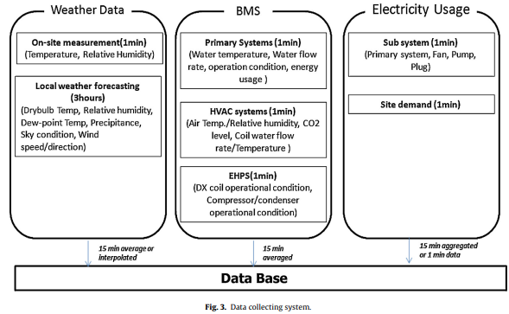
1. Prediction models
2. Artificial neural network model for forecasting sub-hourly electricity usage in Commercial buildings
3. A hybrid model approach for forecasting future residential electricity consumption
Methodological approach
Data collection and processing
Notes:
The relational database management system (RDBMS) has been used to collect and store environmental variables, BMS data, and electricity usage as illustrated here.
Dataset has over 1000 data points with 20 different measurement types. / some variables are not used for forecast.
So the predictors are divided into 3 categories ->

Slide 11
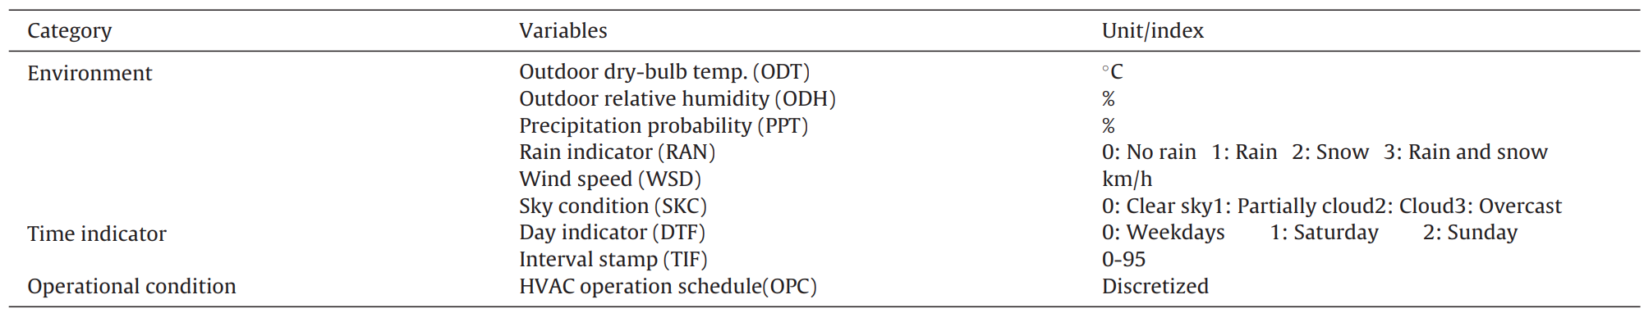
1. Prediction models
2. Artificial neural network model for forecasting sub-hourly electricity usage in Commercial buildings
3. A hybrid model approach for forecasting future residential electricity consumption
Methodological approach
Data collection and processing
> Potential predictor variables
Environmental data
ODT, ODH, PPT, RAN, WSD, SKC
Time indicator
DTF, TIF
Operational condition
OPC
9 potential variables
Notes:
** Environmental data, time indicator, and operational condition.
The data include outdoor air temperature, relative humidity, wind speed and direction, sky condition, and precipitation(강수량) type in every 3-hour interval for the next 72 hours. The forecast data is updated eight times a day.
And RDBMS converts string variables into numeric variables as shown.
An averaged system operation schedule of five CAV systems was used as the HVAC operational condition.
However, In nine independent variables, some variables can decrease model accuracy, stability, and effectiveness. Therefore, it is necessary to pre-screen the variables by identifying the important variables from the input data set.

Slide 12
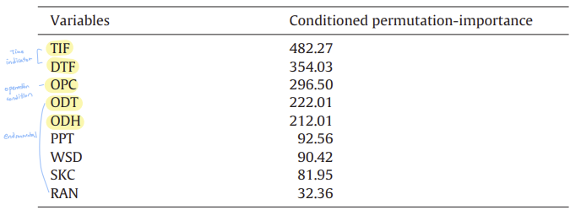
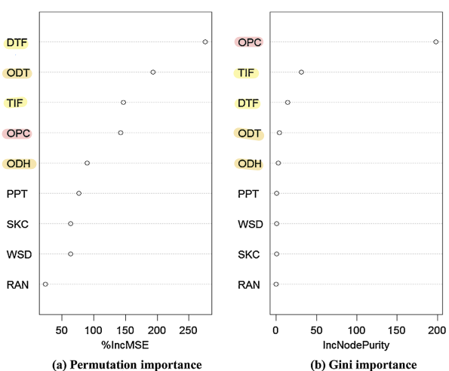
1. Prediction models
2. Artificial neural network model for forecasting sub-hourly electricity usage in Commercial buildings
3. A hybrid model approach for forecasting future residential electricity consumption
Methodological approach
Feature extraction for dimension reduction
5 variables
Random forests algorithm
+ Previous electricity usages
Notes:
So Random forests algorithm was used to assess the importance of variables by measuring the candidate parameters in terms of their impacts on the response of prediction.
The permutation importance and Node impurity were used to select variables in this study
The permutation importance estimates the importance of each predictor by considering prediction error variation when the variable is permuted but others are kept the same. Node impurity is measured by the total decrease in residual sum of squares from splitting on the variable, averaged over all trees.
Variables are ranked by both relative importance metrics in left figure.
According to this, Outdoor air temperature, relative humidity and operational condition has more importance.
It has a similarity to the conditional permutation importance at right Table.
So, these 5 variables are ranked highly in their importance.
These and previous electricity usages are selected as input variables.

Slide 13
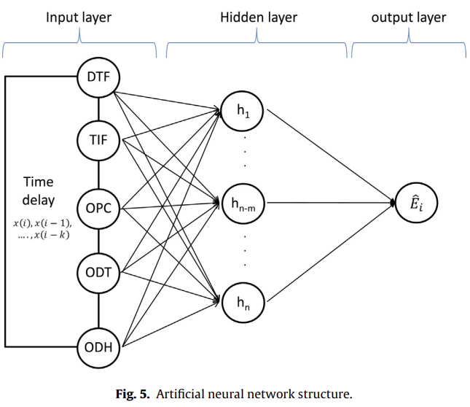
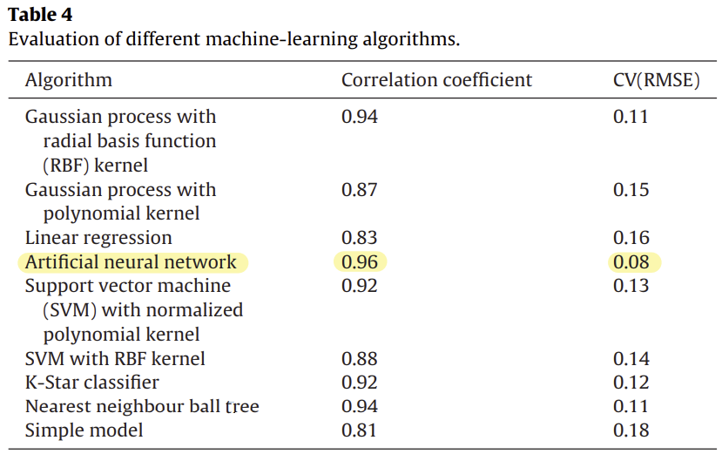
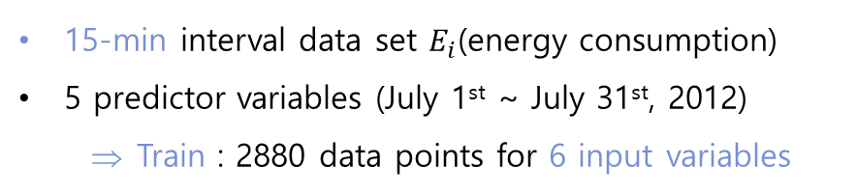
1. Prediction models
2. Artificial neural network model for forecasting sub-hourly electricity usage in Commercial buildings
3. A hybrid model approach for forecasting future residential electricity consumption
Methodological approach
Predictive model selection
ANN model architecture
15-min interval data set $E_{i}$(energy consumption)
5 predictor variables (July 1st ~ July 31st, 2012)
Train : 2880 data points for 6 input variables
> 9 machine-learning algorithms
Notes:
Next, In this study, they examined nine different machine-learning algorithms and chose the one that performed best, the ANN.
The 15-minute interval data set of Ei / and highly ranked 5 predictor variables were collected from July 1st to July 31st, 2012. Total of 2880 data points for 6 input variables including electric usage were used to train the model.

Slide 14
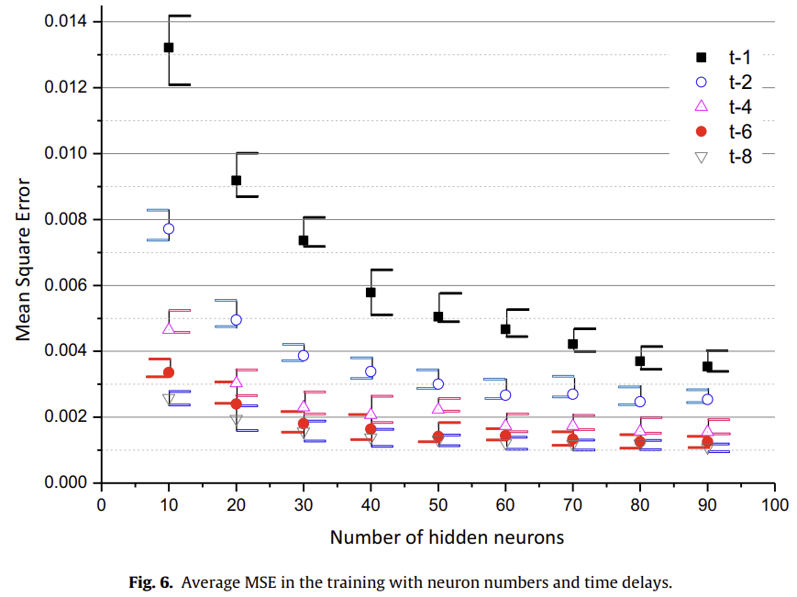
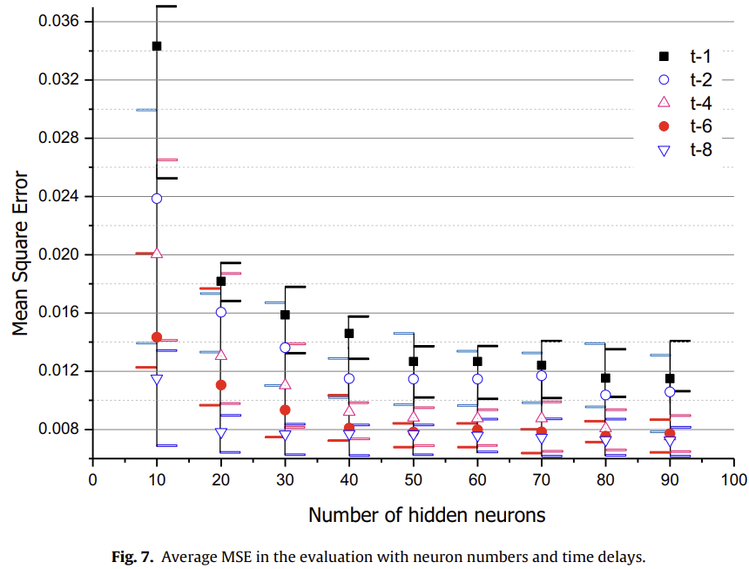
1. Prediction models
2. Artificial neural network model for forecasting sub-hourly electricity usage in Commercial buildings
3. A hybrid model approach for forecasting future residential electricity consumption
Results and discussion
Network design parameters - Hidden layer architecture and time-delayed inputs
Time delay
Stagnant
정체됨
Training
50 neurons & 6h time delay
Evaluation
Notes:
Figs. 6 and7 show average and min/max error range of MSE between the actual energy consumption and the model, presented values in the training and evaluation procedures.
The total neuron number in the hidden layer is varied from 10 to 90. The input-feedback time delay (i-k) is also parameterized, for the time step k = 1, 2, 4, 6, 8 (up to 2 hours).
It shows that the network requires a relatively large number of neurons and time delays to provide a stable performance.
** But MSE is stagnant 정체된 after 50 neurons and time delay 6 hours.
** So Considering the model complexity and computation time, it is reasonable to have 50 neurons in the hidden layer and have t-6 time delay for input variables and feedback for the network model in this study.

Slide 15
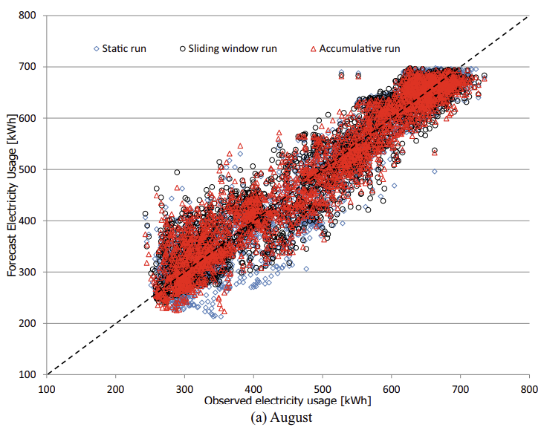
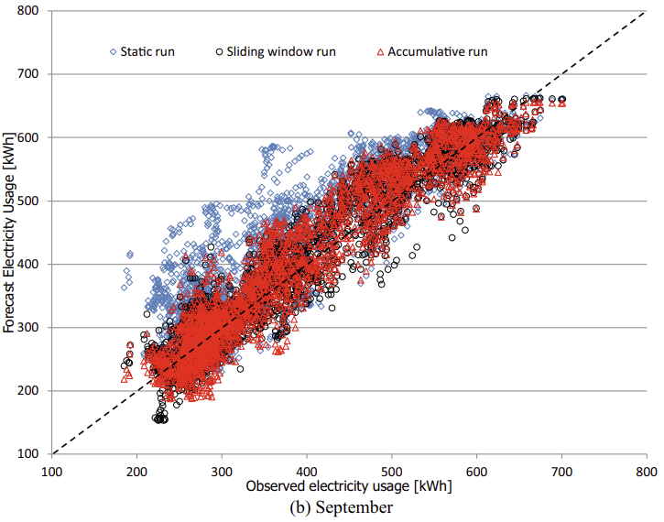
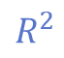
1. Prediction models
2. Artificial neural network model for forecasting sub-hourly electricity usage in Commercial buildings
3. A hybrid model approach for forecasting future residential electricity consumption
Results and discussion
Training method
Static
Accumulative
Sliding windows
Model implementation
> Comparisons of actual observed and forecasted electricity usage
$$R^{2}$$
0.904
0.912
0.902
0.798
0.914
0.919
August
September
Notes:
To verify the forecasting performance of the developed model, two months of data, August and September in year 2012, were used.
Three training methods were considered: static, accumulative, and sliding windows.
For the static training, the model is trained using four weeks of data in July, and it forecasts for August and September without retraining the model with newly available data.
Accumulative training, an adaptive training method, uses accumulated data set from the first day of July to the day before the target day and retrained on a daily basis.
The sliding windows method uses a fixed training data window size (four weeks) and the window is shifted by a day by removing the first day of the old training set and adding the new measurements into the data set. The networks are also retrained daily with the new training data
As illustrated in Fig. 8(a), the overall prediction performance of each training type is similar to each other in August.
** The coefficient of determination (R-square) values is 0.904, 0.912, and 0.902 for each methods.
The result of September shows that accumulative and sliding windows are similar to August, but static training was not good as them.

Slide 16
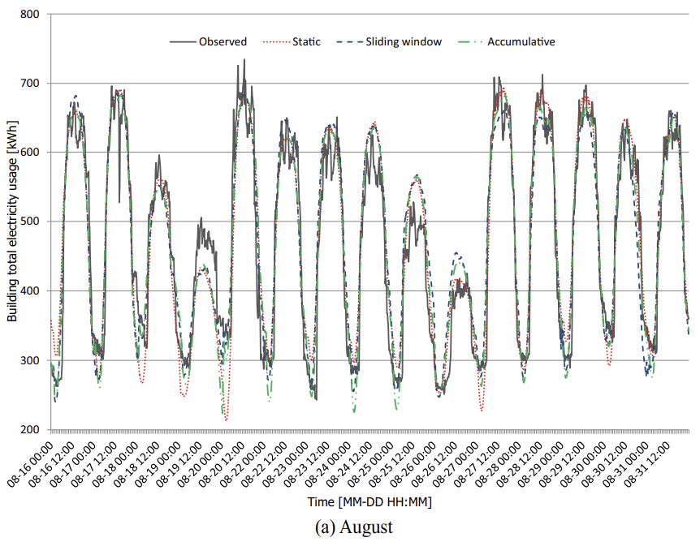
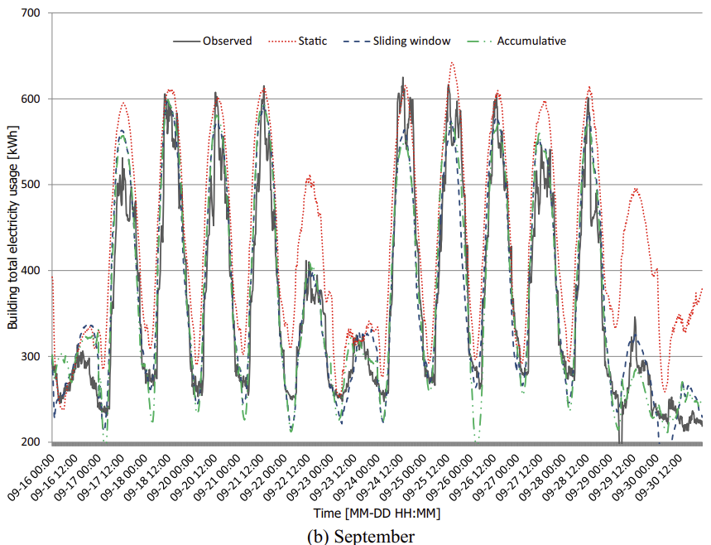
1. Prediction models
2. Artificial neural network model for forecasting sub-hourly electricity usage in Commercial buildings
3. A hybrid model approach for forecasting future residential electricity consumption
Results and discussion
Model implementation
Over estimated
> Actual forecast result
August
September
Notes:
This is actual forecast result.
As shown, The accuracy falls especially for the last week of the month.
-> As seen, It is often overestimated the electricity consumption of weekdays. It may indicate that the energy consumption pattern of the site has changed by the outdoor weather condition. ->

Slide 17
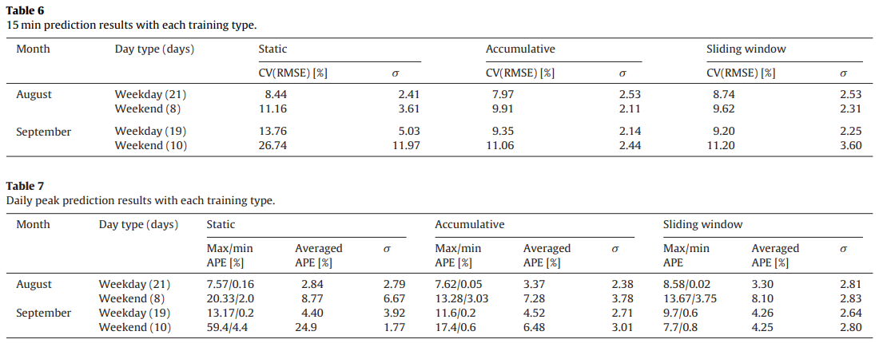
1. Prediction models
2. Artificial neural network model for forecasting sub-hourly electricity usage in Commercial buildings
3. A hybrid model approach for forecasting future residential electricity consumption
Results and discussion
Model implementation
Daily
Daily
peak
Notes:
The first table presents the statistical summary of CV(RMSE) and its standard deviation 세타 on daily level.
All three run types of training set have a similar performance in August, but static training error is higher than others in September, as shown before. ←
Second table summarizes the daily peak forecasting performance on weekdays and weekends for the two months
As similar to the daily prediction performance, the adaptive training method, accumulative and sliding window, provides more accurate results ** with smaller variance than the static training in September.
With the regard of the uncertainty of actual electricity consumption in the short-term intervals, the day-ahead peak demand forecasting performance by the developed model is reasonable enough to make a management plan for the daily electricity consumption and peak electricity demand in the building.

Slide 18
1. Prediction models
2. Artificial neural network model for forecasting sub-hourly electricity usage in Commercial buildings
3. A hybrid model approach for forecasting future residential electricity consumption
Conclusion
The short-term load forecast (STLF) – sub-hourly electricity consumption of buildings
Still a challenging problem – complexity of usage pattern & highly noisy input data
A new approach – using feature extraction and an ANN
→ A-day-ahead forecast of the electricity usage for a commercial building complex (15 min)
Developed model for 2 months
Daily error : stable around averaged CV of 10%
Daily peak demand : averaged APE of 5%
The model can provide a day-ahead electricity usage profile with sub-hourly intervals and daily peak electricity consumption with a reasonable accuracy
A good predictive model of energy consumption in buildings
→ Useful in developing a good model predictive control (MPC) method that can reduce energy costs in buildings.
Notes:
In conclusion,
on model development for short term electricity load forecast,
the sub-hourly electricity usage forecast is still a challenging problem due to the complexity of usage pattern and the highly noisy input data.
In this study, they demonstrated a new approach using a feature extraction and an artificial neural network
to make a-day-ahead forecast of the electricity usage profile for a commercial building complex in a high temporal resolution of 15 minutes.
The implementation results of the developed model for two months illustrate that the daily error with 15-minute resolution forecasting is stable around averaged CV(RMSE) of 10% for weekdays (coefficient of variation)
and the model predicts the daily peak demand of weekdays within averaged APE of 5% for the period. (Absolute percentage error)
It implies that the model can provide a day-ahead electricity usage profile with sub-hourly intervals and daily peak electricity consumption with a reasonable accuracy.
A good predictive model of energy consumption in buildings is useful not only for accurately forecasting future energy consumption
/ but also in developing a good model predictive control (MPC) method that can reduce energy costs in buildings.

Slide 19
3. A hybrid model approach for forecasting future residential electricity consumption
1. Prediction models
2. Artificial neural network model for forecasting sub-hourly electricity usage in Commercial buildings
3. A hybrid model approach for forecasting future residential electricity consumption
Dong B, Li Z, Rahman SMM, Vega R. Energy Build 2016;117:341–51..
Notes:
Next paper is ‘A hybrid model approach for forecasting future residential electricity consumption’

Slide 20

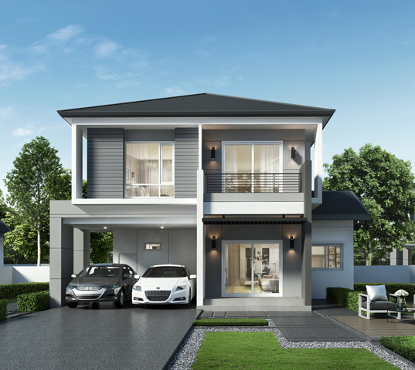
1. Prediction models
2. Artificial neural network model for forecasting sub-hourly electricity usage in Commercial buildings
3. A hybrid model approach for forecasting future residential electricity consumption
Introduction
Data-driven - Black-box : machine learning driven, derived by measured data
Limited in one type of methods (neural networks)
Physical + Data-driven = Grey-box
Built upon physical relationship – parameters of physical model are unknown or uncertain.
+ Measured data → identify those parameters, model tuning for better accuracy
Commercial vs Residential building
The lack of hourly or more granular data
The growing percentage of miscellaneous electrical load (MEL) in residential building (~52%)
기타 전기부하 비율
A new hybrid modeling approach
Forecast hour ahead and 24 ahead residential electrical load
Notes:
“Data-Driven” models rely more on the data, assuming there is already a mathematical relationship between inputs (e.g. weather parameters) and outputs (e.g. total building energy consumptions).
To further categorize the “Data-Driven” approach, there are “black-box” and “grey-box” models.
The “black-box” model is purely machine learning driven and derived by measured data. Previous studies on energy consumption forecasting using “black-box” models are limited in one type of methods such as neural networks.
The “Grey-box” model is built upon physical relationships, while the parameters of the physical model are usually unknown or uncertain.
The measured data is used to identify those parameters and model tuning for better accuracy.
The “Grey-box” models have been applied widely to estimate commercial building heating and cooling load, not many on the residential building sector.
The research gap between commercial and residential building comes from two main sources,
which are (a) the lack of hourly or more granular data 세분화된 데이터, and (b) the growing percentage of miscellaneous electrical load (MEL) 기타 전기 부하 비율의 증가 in residential building, respectively.
It is 15-25% but expected to increase 52% by 2040.
But for residential building, none of Previous models can work as good as, because MEL is not weather related, and occupies a large portion of total building energy consumption.
So in this paper they try to close this gap by developing a new hybrid modeling approach through integrating “physical” and “data-driven” models
to forecast hour ahead and 24 h ahead residential electrical load.

Slide 21

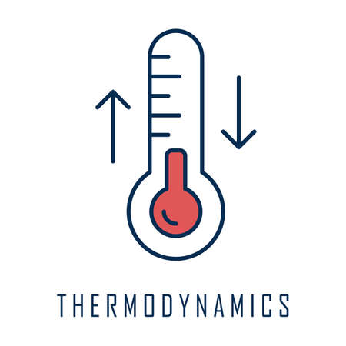
1. Prediction models
2. Artificial neural network model for forecasting sub-hourly electricity usage in Commercial buildings
3. A hybrid model approach for forecasting future residential electricity consumption
Current state of the art
Data-driven models – machine learning algorithms
ANN, SVR, LS-SVM, GPR, GMM
Only conducted on total building energy consumption forecast
Physical models (Forward models) - Use laws of thermodynamics (열역학)
2 main parts : Building thermal zone envelopes / Air conditioning modeling
Physical phenomena (convection, conduction, radiation) → 1 layer
All layers (walls, floor, roof, etc.) → Thermal envelope zone (thermal resistance-capacity (RC) networks)
Suffers from a lack of building information
Limited to thermal usage prediction such as air conditioning
A new hybrid modeling approach
Forecast both total and air-conditioning (AC) energy consumption
Notes:
Physical models use laws of thermodynamics. There are two main parts of a model:
building thermal zone envelopes and air conditioning modeling.
For simplicity, most models integrate all physical phenomena (convection, conduction, and radiation) to one layer, and all layers (walls, floor, roof, etc.) to a thermal envelope zone. Thus, the envelope of the thermal zone in a building can be constructed as thermal resistance-capacity (RC) networks.
In energy forecast applications, physical model suffers from a lack of building information
Furthermore, many tests involved in data-driven methods are only conducted on total building energy consumption forecast.
In contrast, physical models are limited to thermal usage prediction such as air conditioning.
Our research proposes a hybrid approach, making use of forward and data-driven models to forecast both total and air-conditioning (AC) energy consumptions.

Slide 22
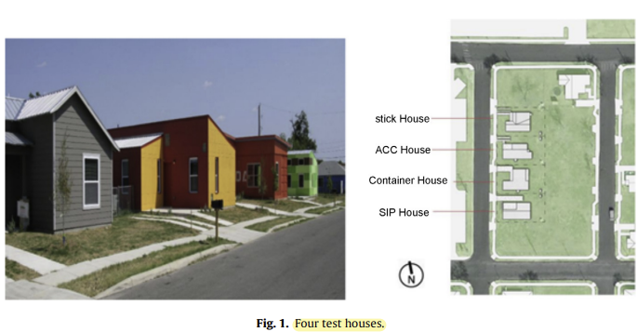
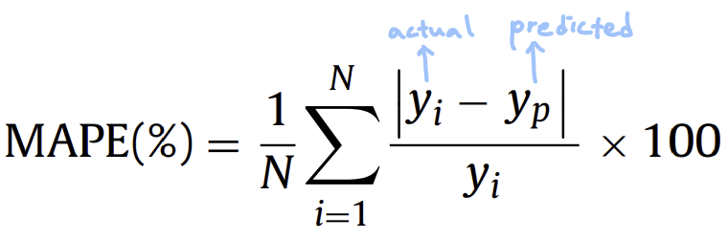
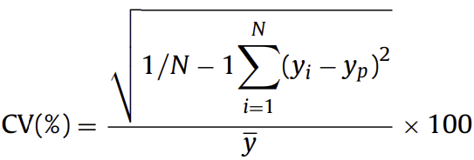
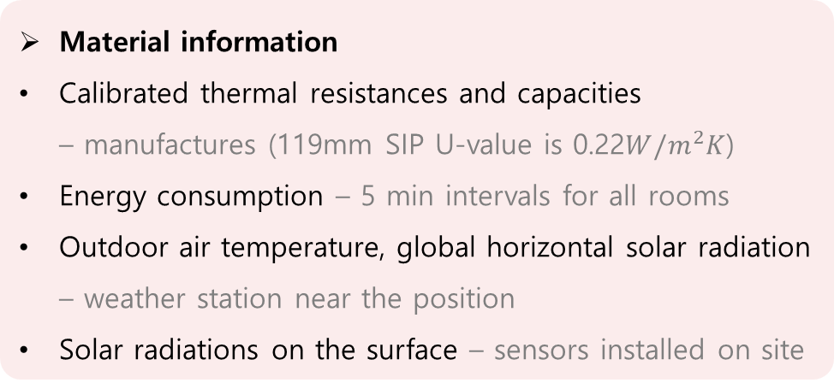
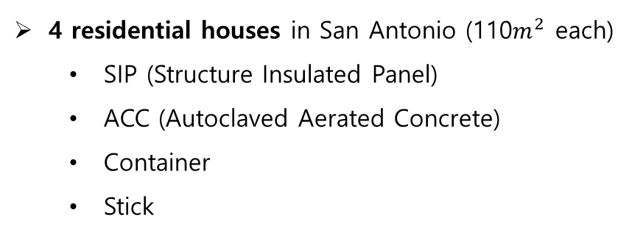
1. Prediction models
2. Artificial neural network model for forecasting sub-hourly electricity usage in Commercial buildings
3. A hybrid model approach for forecasting future residential electricity consumption
Methodology and approach
Test bed and performance metrics
Material information
Calibrated thermal resistances and capacities – manufactures (119mm SIP U-value is 0.22$W/m^{2}K$)
Energy consumption – 5 min intervals for all rooms
Outdoor air temperature, global horizontal solar radiation – weather station near the position
Solar radiations on the surface – sensors installed on site
4 residential houses in San Antonio (110$m^{2}$ each)
SIP (Structure Insulated Panel)
ACC (Autoclaved Aerated Concrete)
Container
Stick
Hour ahead, 24-h ahead models – evaluated
% of error per prediction
Smaller is better
Variation of overall prediction
Smaller, more similar dispersions
Notes:
The residential data in our research was collected from four residential houses in San Antonio as shown. Those four samples are single family dwelling around 110 m2 each.
Houses are named according to construction materials: SIP, ACC, Container, and Stick.
For material information, // those are measured by each places. /// calibrated thermal resistances and capacities are provided by manufacturers. Energy consumptions are monitored at 5 min intervals for all the rooms including kitchen, bathroom, living and bedroom areas. Sub-metered data such as plugs, lighting, water heater and AC are also available. Outdoor air temperature and global horizontal solar radiation are collected from a weather station near the position. Solar radiations on the surface of each house at the same period are measured from sensors installed on site. ///
Hour ahead and 24-h ahead models are evaluated using performance metrics: mean absolute percentage error (MAPE), and coefficient of variation (CV) of root mean square error.

Slide 23
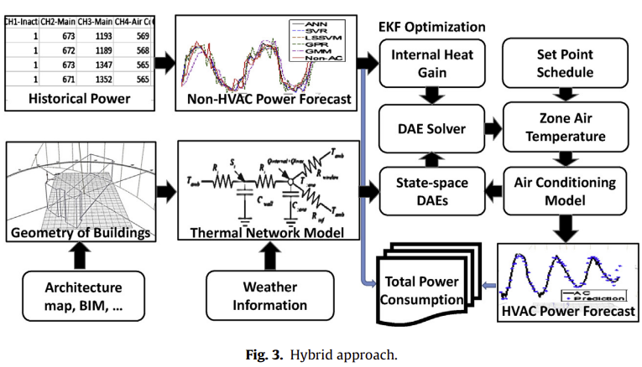
1. Prediction models
2. Artificial neural network model for forecasting sub-hourly electricity usage in Commercial buildings
3. A hybrid model approach for forecasting future residential electricity consumption
Methodology and approach
Hybrid model
Historical information → Forecast non-AC electricity consumption → Internal heat gain
Predicted weather + internal gain forecast → The thermal network differential algebraic equations (DAEs) → Zone temperature + Set point schedule → AC regression model
AC + non-AC = a total electricity consumption
Notes:
First, we forecast non-AC electricity consumption from historical non-AC consumption information. As internal heat gain is highly correlated with non-AC electricity consumption, it can be directly estimated from the non-AC prediction using heat convection and conduction.
Secondly, predicted weather together with the internal heat gain forecast are inputted to the thermal network differential algebraic equations (DAEs)to simulate zone temperature. Then, the calculated zone temperature change is updated to an AC regression model with a set point schedule. Afterward, the AC cooling power consumption is further predicted. By summing up the AC and non-AC predictions, we have a total electricity consumption.

Slide 24
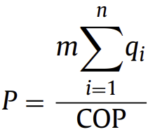
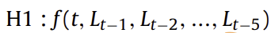
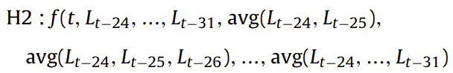
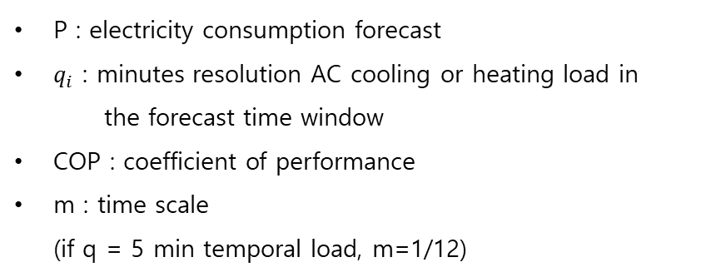
1. Prediction models
2. Artificial neural network model for forecasting sub-hourly electricity usage in Commercial buildings
3. A hybrid model approach for forecasting future residential electricity consumption
Methodology and approach
Hybrid model
Non-AC forecast
AC forecast
Hour ahead
Previous 1-5 h historical load information
24-hour ahead
Previous 24-31 h historical load + moving averages
P : electricity consumption forecast
$q_{i}$ : minutes resolution AC cooling or heating load in the forecast time window
COP : coefficient of performance
m : time scale (if q = 5 min temporal load, m=1/12)
Notes:
For the non-AC forecast, the target is the non-AC energy consumption standing for plug load, lighting, water heater etc.
The hour ahead input set, defined as H1, is used to forecast the non-AC load L_t at hour.
The features are this, where Lt−1 represents the historical non-AC electricity consumption for the previous 1 h.
For the hour ahead forecast case, input shows that the features need previous 1–5 h historical load information.
The 24-h ahead input set, defined as H2, is used to forecast the next 24-h load Lt to Lt+23
For one future time load Lt of the next 24-h window, the required input features are these.
They needs not only previous 24–31 h historical load but also moving averages.
For the AC forecast, electricity consumption of the AC system can be found, as expressed by this equation.

Slide 25
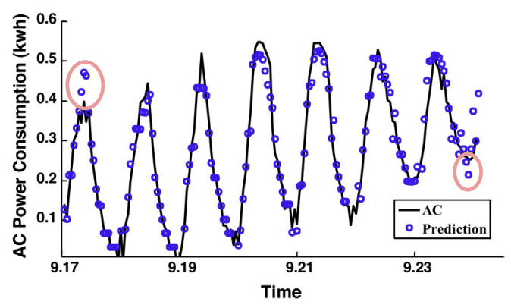
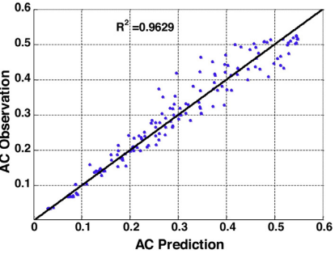
1. Prediction models
2. Artificial neural network model for forecasting sub-hourly electricity usage in Commercial buildings
3. A hybrid model approach for forecasting future residential electricity consumption
Results and discussions
Train - 1 week ~ 1 month before tested period (before 2013.9.17)
Test - 1 week (2013.9.17 ~ 2013.9.24)
AC / non-AC / total building energy consumption
Air-conditioning energy consumption
Insensitive
# MAPE
SIP : 7.03%
ACC : 8.29%
Container : 9.15%
Stick : 8.03%
Peak
Transitional stages
> SIP house
> MAPE
Notes:
For evaluation of the hybrid approach, 1 week from 2013.9.17 to 2013.9.24 is tested for all the residential houses. One week up to 1 month of non-AC power consumption data before the tested period is used for training.
The experimental results of forecasting are organized in the following order: AC, non-AC, and total building energy consumption.
As the first step of hybrid modeling approach, we need to forecast the AC air conditioning energy usage.
MAPEs are like this for each houses. An example of SIP house is plotted as this.
** Most errors are beyond the baseline are due to the insensitivity of the model to AC cooling peak or transitional stages.
With an R squared value of 0.9629 shown in next figure, the forecasts show fairly accurate predictions on AC power consumption.

Slide 26
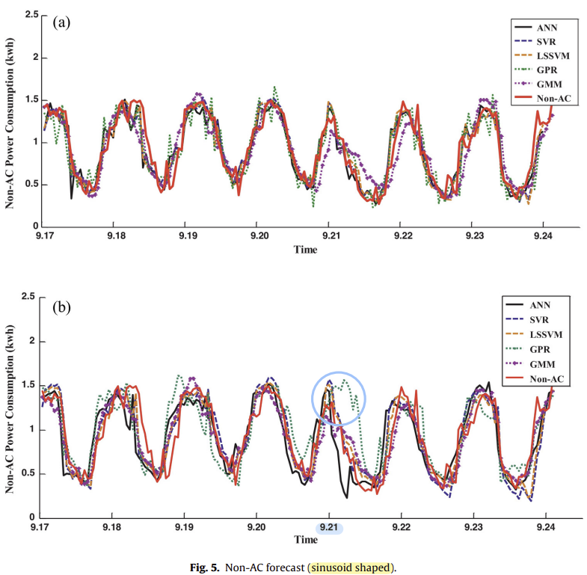
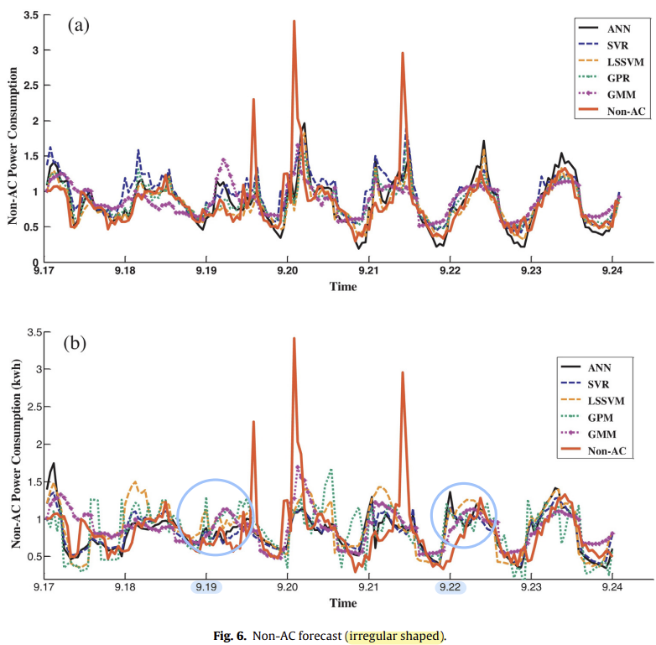
1. Prediction models
2. Artificial neural network model for forecasting sub-hourly electricity usage in Commercial buildings
3. A hybrid model approach for forecasting future residential electricity consumption
Results and discussions
Non-air-conditioning energy consumption
Hour
Forecasting performance↓
Forecasting performance↓
24 h
> Sinusoid shape
Over fitting
> Irregular shape
Insensitive
Notes:
Next, For the non-AC energy forecasting, they conducted a comparative analysis of five data-driven methods (ANN, SVR, LSSSVM, GPM and GMM). These are results of SIP and ACC houses.
They present 2 types of common energy patterns observes : Sinusoid사이너소이드 and irregular shaped.
For the sinusoid patterns, traditional methods have good performances with MAPE below 10%.
For the irregular patterns, some methods are still able to account for the larger variation, ** but forecasting performance decreased.
Results of 24-h ahead forecasts are significantly different than hour ahead cases. **
They cannot keep the same performance for 24-hour ahead cases.
**
The predictions are either over fitting or insensitive as shown.

Slide 27
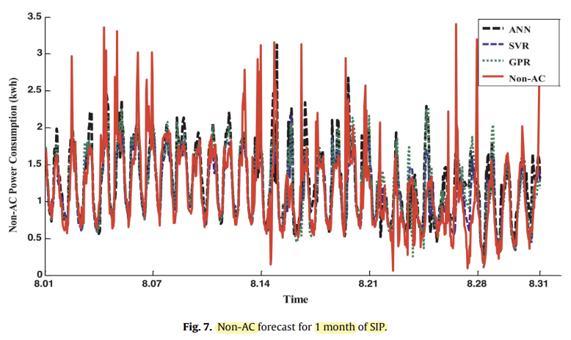
1. Prediction models
2. Artificial neural network model for forecasting sub-hourly electricity usage in Commercial buildings
3. A hybrid model approach for forecasting future residential electricity consumption
Results and discussions
Non-air-conditioning energy consumption
> 1 month of SIP
Reduced performance due to
Constraints on input feature
Hour : previous 1~5 h
24-h : yesterday
→ Key assumption :
Daily usages are similar without large deviation
Random behavior of residents creates the randomness
Inability to capture the random spikes
→ Short period of time (5 min)
Notes:
The reduced performance for 24-h ahead forecasts is due to model limitations and input constraints.
Constraints on input feature selections are not obvious in hour ahead cases since the training features include previous 1-5 hour.
However, for 24-hour ahead, models learned the patterns only from yesterday.
Thus, the successfully prediction of longer forecast window is based on one key assumption: daily usages are similar without large deviation, 매일 사용량이 유사하다.
This figure shows an example for forecasting a longer period, 1 month, using representative techniques, SVR, ANN and GPR.
Most large forecast error reveal models’ inability to capture the random spikes in energy consumption
that occur for short period of time, like within 5 minute.

Slide 28
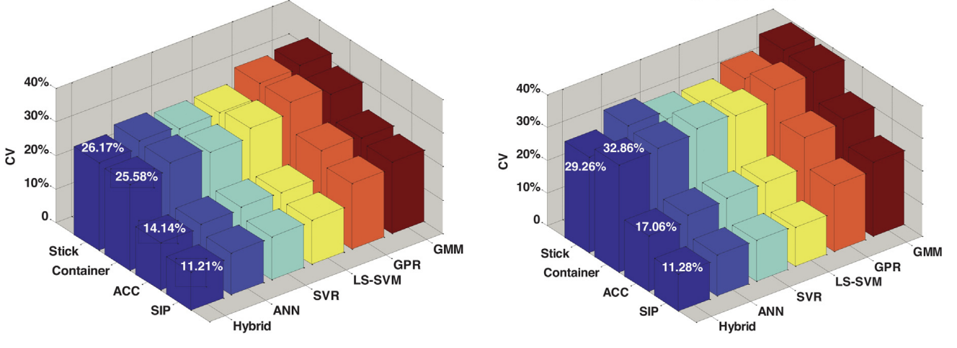
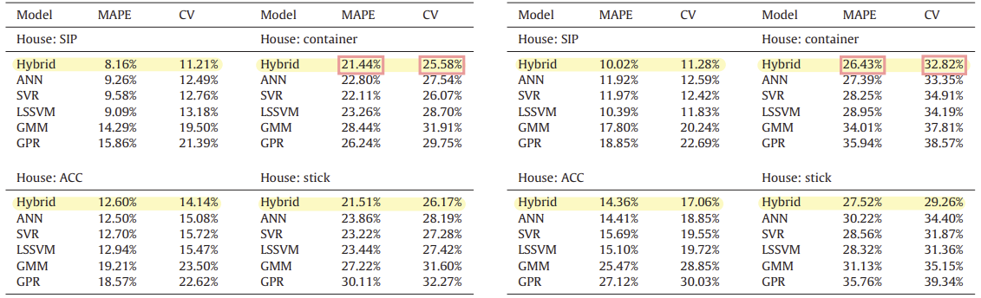
1. Prediction models
2. Artificial neural network model for forecasting sub-hourly electricity usage in Commercial buildings
3. A hybrid model approach for forecasting future residential electricity consumption
Results and discussions
Total building energy consumption
Temporal variance has a significant impact on the predictive capability
> CV
> CV
> Hour ahead
> 24-hour ahead
Notes:
Finally, for the total building energy consumption, each hour ahead and 24-hour ahead forecast performance are visualized on MAPE and CV.
In terms of CVs, the best method for hour ahead electricity consumption forecasting is the hybrid model.
Meanwhile, in terms of MAPE, hybrid model, ANN, SVR, and LSSVM are not significantly different.
However, some improved results from the hybrid approach can be observed in figure.
Also 24 h ahead forecasting results find similar patterns. The hybrid model tends to have lower MAPE and CV values.
However, the forecasting error compared to hour ahead is statistically distinct. ** 24-hour forecast’s MAPE and CV are higher than hour ahead forecast. .
This implies that temporal variance (hour or 24 h ahead) in the forecasting window has a significant impact on the predictive capability of both data-driven and hybrid models
Models trained with historical information with more recent load information has higher chances to characterize the electricity consumption behavior at an hourly interval.

Slide 29
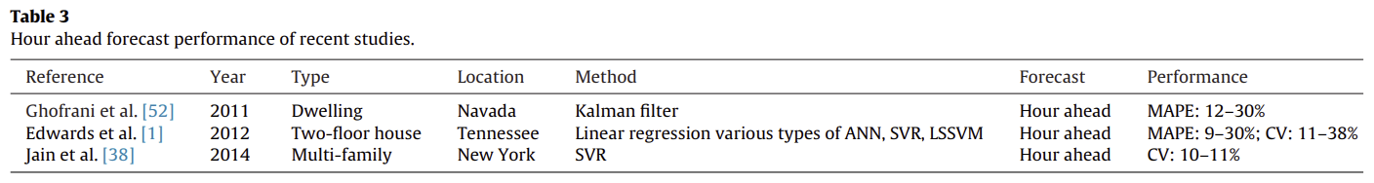
1. Prediction models
2. Artificial neural network model for forecasting sub-hourly electricity usage in Commercial buildings
3. A hybrid model approach for forecasting future residential electricity consumption
Results and discussions
Discussions
3 previous research for hour ahead total energy consumption forecasting of residential buildings
MAPE : 9% ~ 30%
CV : 10% ~ 38%
Our hybrid approach is slightly better than other existing models
Hybrid approach
Improvements – decomposition of total building energy consumption
Isolate certain appliances (AC)
Simultaneous prediction 동시 예측 – both total & sub-meter appliances (AC)
Notes:
In the residential building energy research sector, forecasting is difficult due to the large variation of energy patterns from stochastic occupancy behavior. 확률적 행동
Three previous research studies for hour ahead total energy consumption forecasting of residential buildings are presented in Table.
The forecasting error is considered reasonable if the model returns MAPE values between 9% and 30%, and CV values between 10% and 38% for hour ahead.
We can conclude our hybrid approach is slightly better than the other existing models.
For the hybrid approach, the improvements can be traced back to the decomposition of total building energy consumption.
By isolating certain appliances such as air conditioning, electricity usages are filtered to a sub-meter level.
Another capability of the hybrid approach is the simultaneous prediction on both total energy consumption and sub-meter appliances, such as AC.
This will be a valuable feature for the application of HVAC optimization and advance control strategies such as model predictive control.

Slide 30
1. Prediction models
2. Artificial neural network model for forecasting sub-hourly electricity usage in Commercial buildings
3. A hybrid model approach for forecasting future residential electricity consumption
Conclusion
An innovative hybrid modeling approach for residential building energy consumption forecasting
Data-driven + physic-based models
Single-family residential houses
Validated through 1 month measured data – 4 residential buildings
Hybrid modeling approach
Hour ahead : slightly better
24-h ahead : similar
AC prediction - 5 min interval data
→ Not typically available to homeowners and utility companies
Future
Using hourly data
Improve 24h ahead forecasting
Notes:
For conclusion, This paper aims to develop and demonstrate an innovative hybrid modeling approach for residential building energy consumption forecasting.
The proposed modeling approach was validated through 1 month measured data from four residential buildings
The final data analysis shows that hybrid modeling approach is slightly better for the hour ahead forecasting in terms of CV.
For the 24-h ahead forecasting, all results are similar.
The study presented here uses 5 min interval data to predict AC electricity usage. However, such data is not typically available to home owners and utility companies.
So In the future, we will explore the model performance by using hourly data.
Further study is also required to understand and improve 24 h ahead forecasting.
Accurate residential building forecasting in the energy consumption is critical to improve energy efficiency.
Fully use of monitored data to understand and explore not only total energy usage but also appliances such as air conditioning will help promote demand response programs and develop energy benchmark models.

Slide 31
Thank You! 😊🎉

